Slide 1
Analysis of Robbery
Group 3
Aysha Khan Aditya Patil

Slide 2
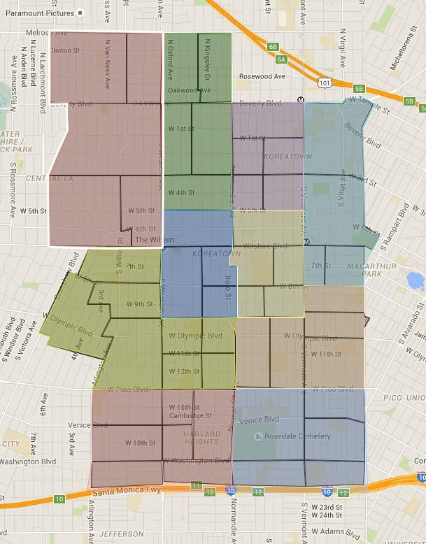
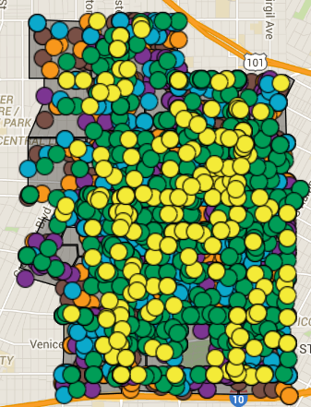
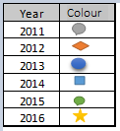
Descriptive Analysis Of Robbery
Basic Car and RD Location
Crime Location- 2011 to 2015

Slide 3
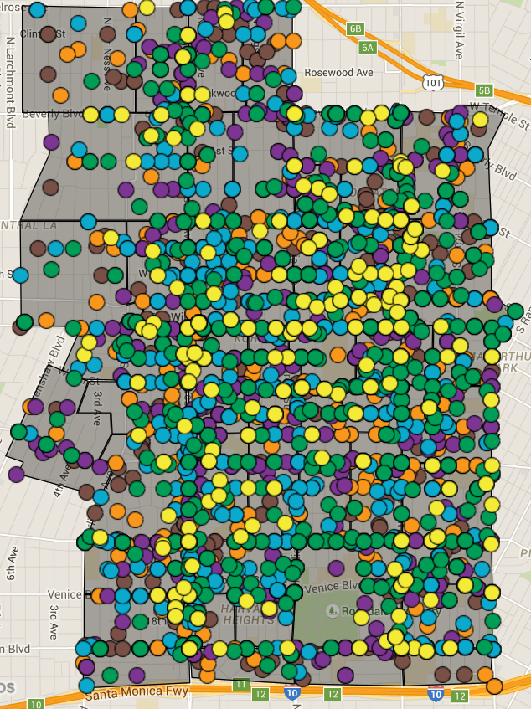
Descriptive Analysis Of Robbery
2815 crimes reported from 2011-2015.
Analyzed Variables used are: Crime Type, Location, Start Time, Day of crime, Vehicle, RD.

Slide 4
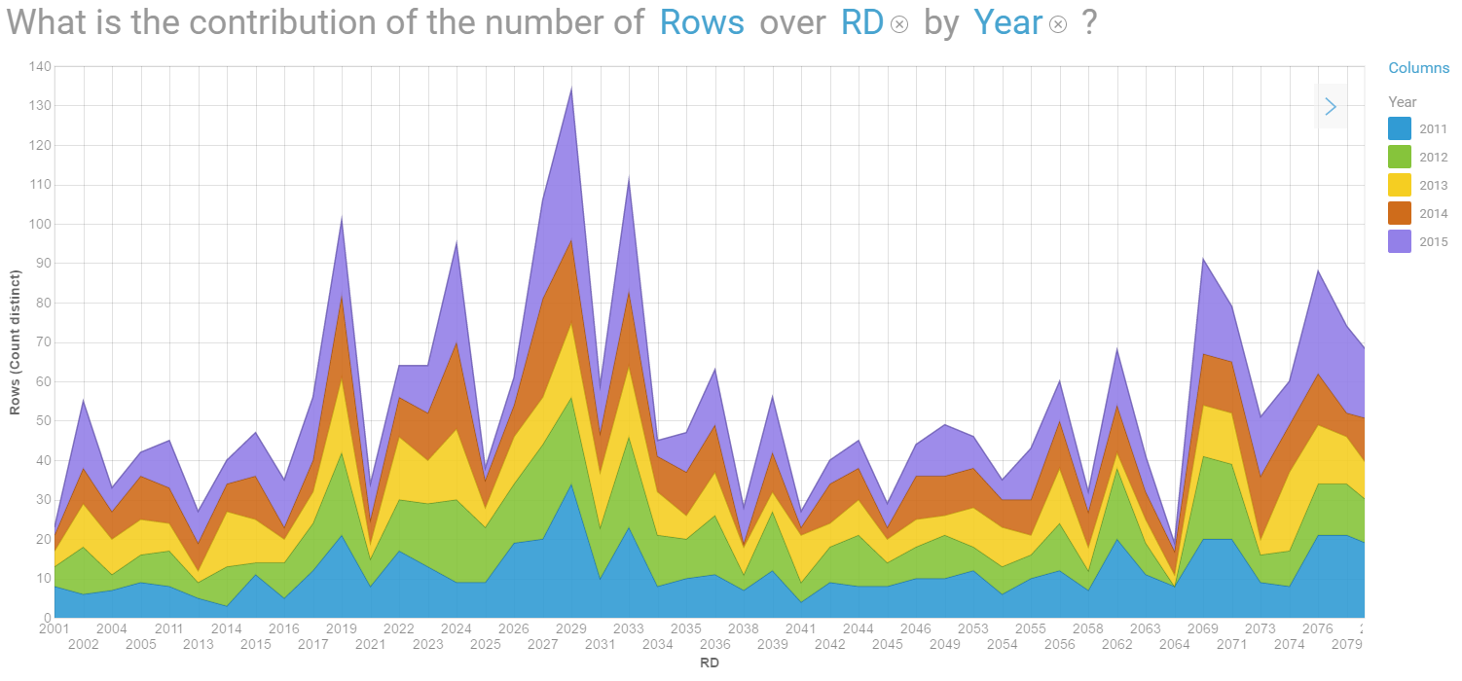
Frequency of crimes by reporting districts
Frequency of Crimes according to year 2011-2015 are highest in RD 2029, 2027, 2033, 2019, 2074.
Year | RD
2011 | 2029
2012 | 2027
2013 | 2074
2014 | 2027
2015 | 2029

Slide 5
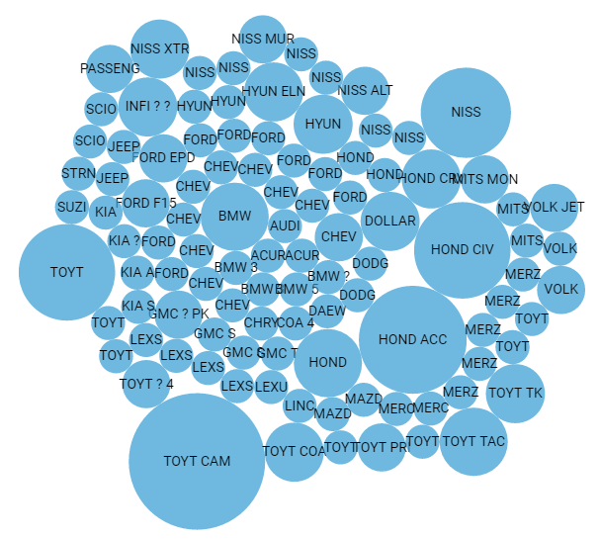
Vehicle Used In Robbery
Toyota Camary & Toyota Corolla are most used vehicle in Robbery.
Second highest used vehicle used is Honda Accord & Honda civic.

Slide 6
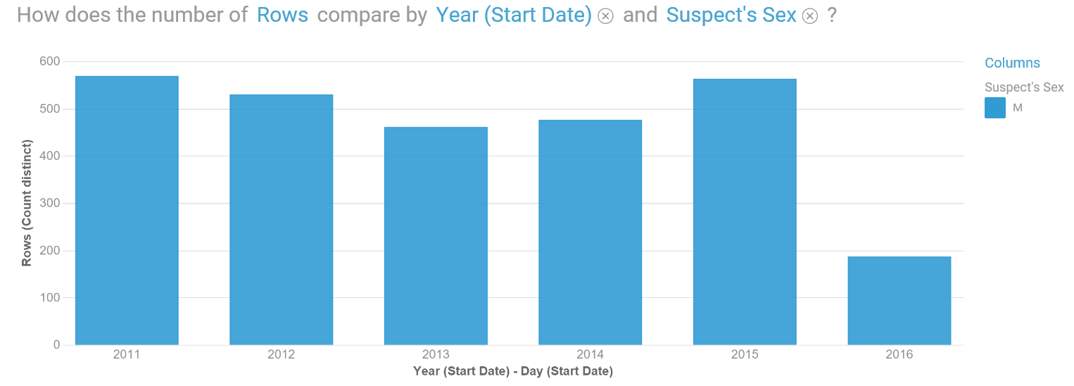
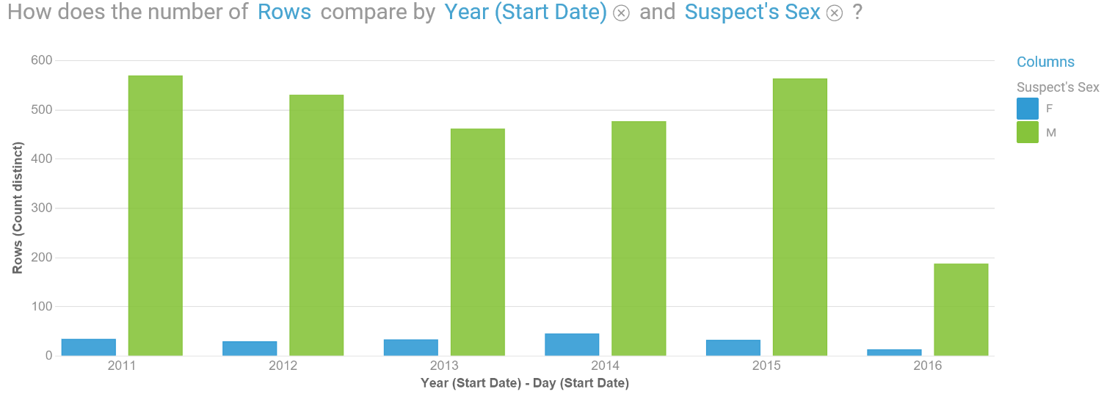
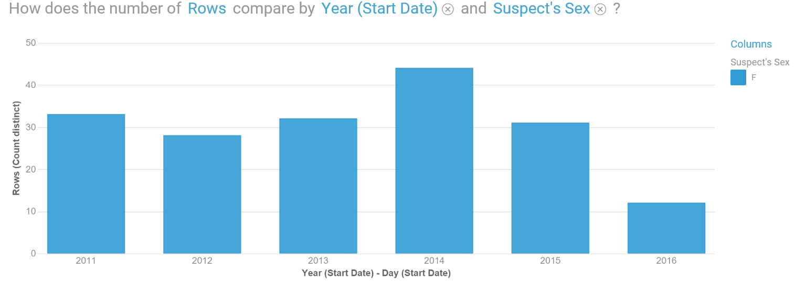
Number of crimes In a Year: Males vs females
We have observed from the data that the number of crimes are done by Males with the highest being 580 during 2015.
The females are much lower in comparison to males at highest number of 44 in 2015

Slide 7
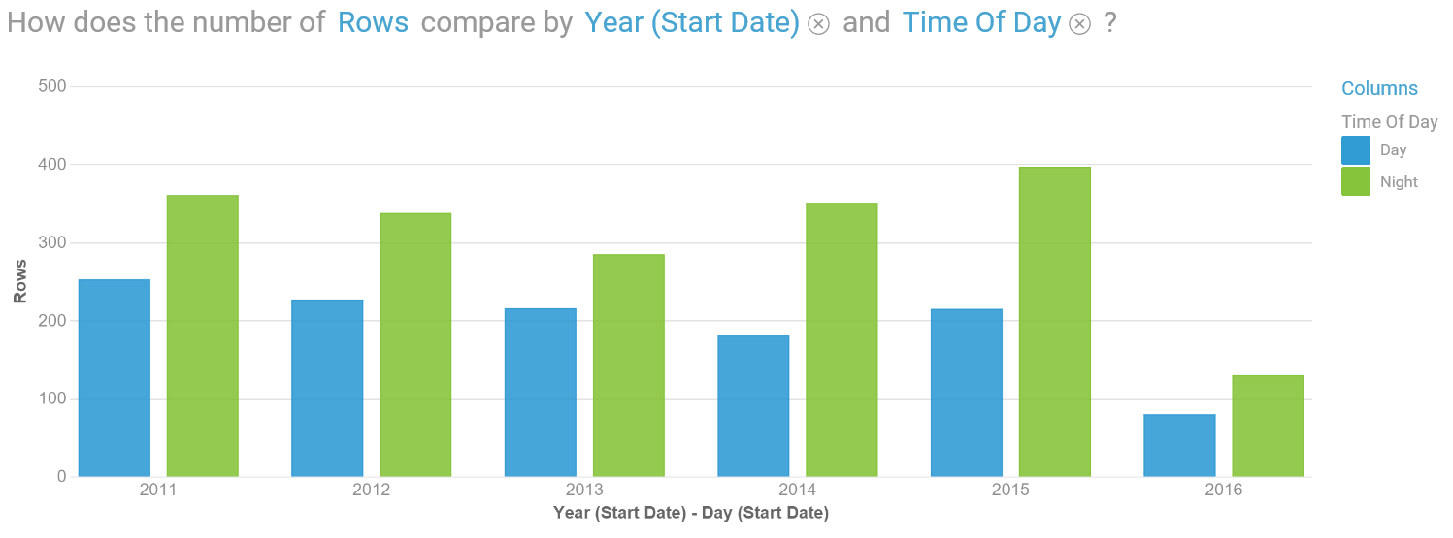
Crime Rate For Robbery
As it can be observed from the above graph the crime rate is higher at night.
Factors may include lower number of officer on duty.
The location are not well lit.

Slide 8
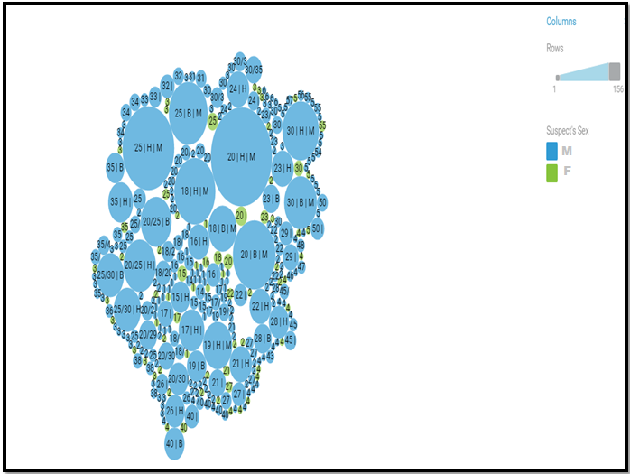
Predictive Analytics : Robbery
The perpetrators profile includes mostly males ranging between 20 – 30 years of age.
Based on the provided data the racial profile includes : highest perpetrators being Hispanic followed by Blacks and lowest being Whites.
The above combined are used to calculate the threat level.
The largest bubbles have the highest threat level of committing Robbery.

Slide 9
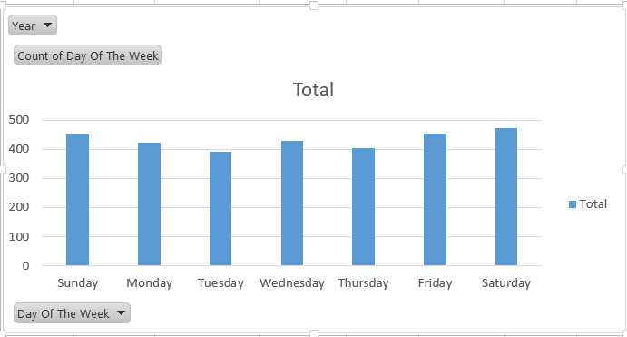
Predictive Analytics : Robbery
2029 | 2027 | 2033 | 2019 | 2024 | 2069
146 | 123 | 118 | 110 | 102 | 99
Most Affected RD : Overall 6 out of 53 with maximum crime.
Most Affected Crime Time : Night

Slide 10
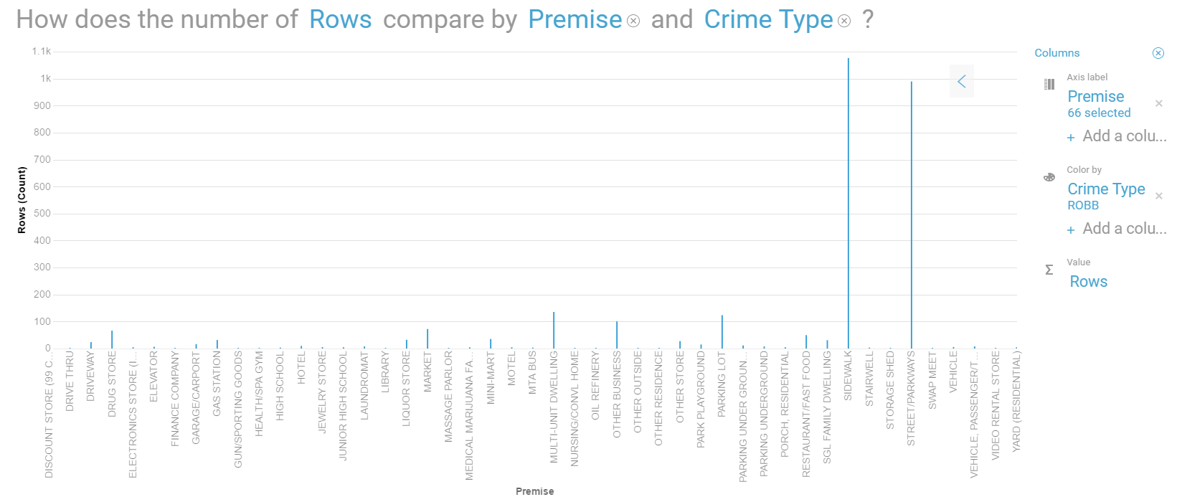
Crime Premise
Sidewalk is the most common premise with highest number of 1.1 K crimes.
Street/Parkways is the second highest robbery place with number 1K.

Slide 11
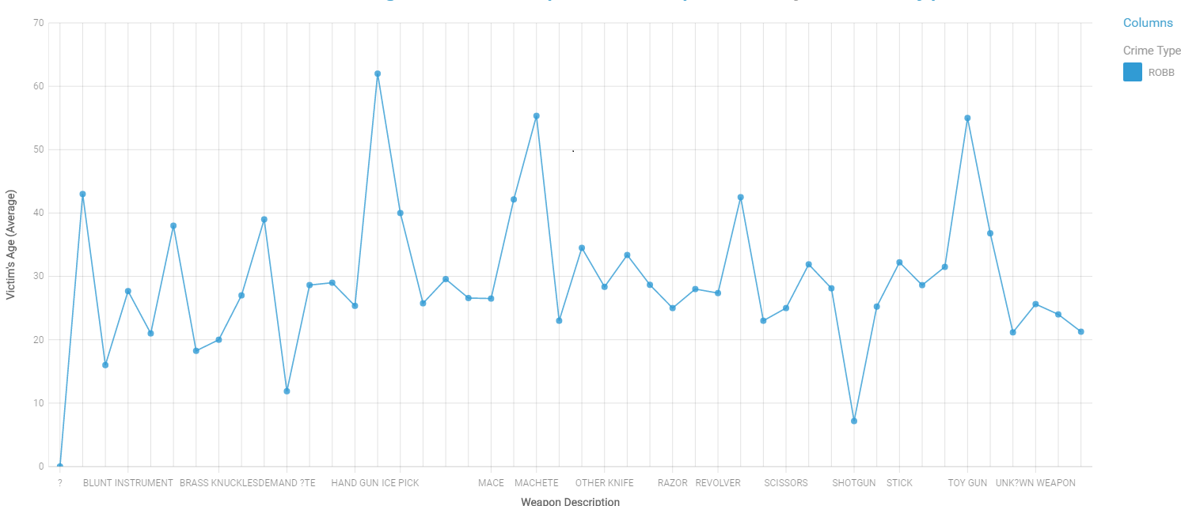
Weapon
Ice Pick is the most common weapon used in the robbery crime.
Hand Gun is the second most used weapon in robbery followed by Toy Gun.

Slide 12
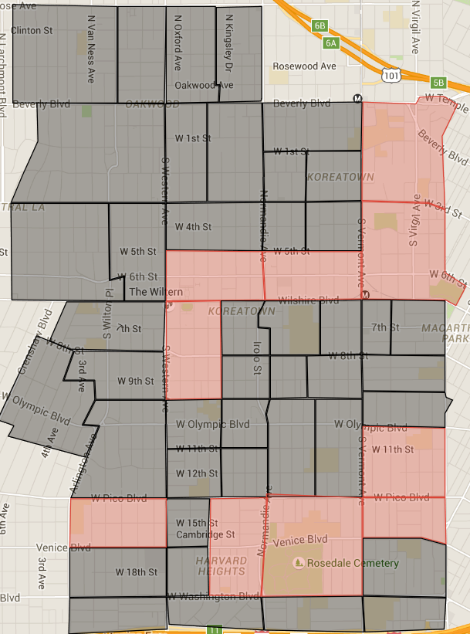
Prescriptive Analysis of Robbery
Within RD 2029, patrol should emphasis on:
334 S Vermont Ave, Los Angeles.
Within RD 2029, patrol should emphasis on:
3rd& Vermont, Los Angeles.
Within RD 2027, patrol should emphasis on:
6th St & Kenmore Avenue.
Within RD 2074, patrol should emphasis on:
2053 Venice Blvd, Los Angeles.

Slide 13
Conclusion
The watch team should be careful during their shifts, specially from 4pm to 4am.
Patrols should be more careful in preventing Robbery all week long with extra emphasis on Friday, Saturday and Sunday.
More variables such as educating people not to post vacations plan on social networking sites.
Avoid carry purse and if you do avoid hanging it free from your hand.
Try to walk in open and well lit areas.

